Slide 1



UNIT 2: Home is where heart is
I my home

Slide 2
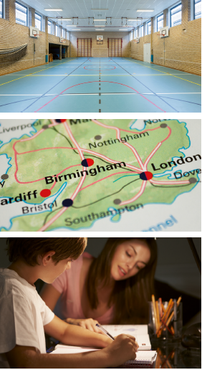
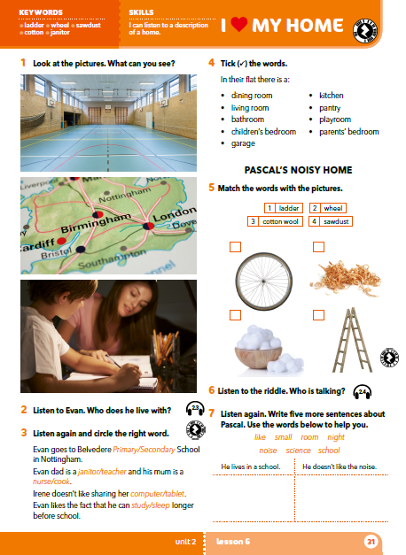
What can you see?
Listen to a boy talking about his life. What do you think is special about this boy?
These pictures tell us something about his life. What do you think it is?

Slide 3

Listen to the recording and answer the question.
Who does he live with?
Ewan lives with his family: mom, dad and a sister.
Do you know what these words mean?
Primary school –
Secondary school –
Janitor –
osnovna škola
srednja škola
domar

Slide 4
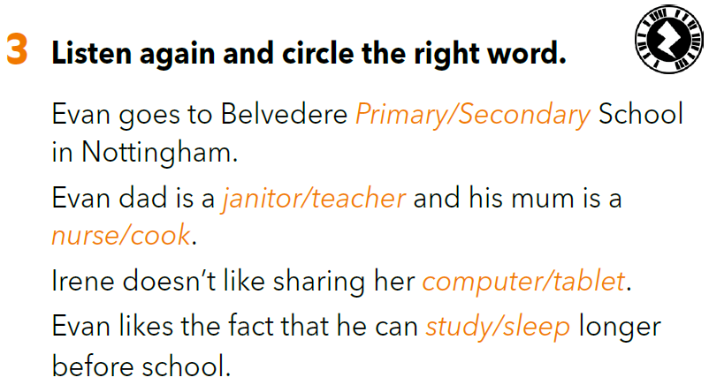

Slide 5
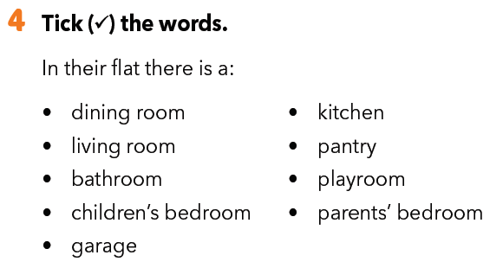
Which rooms are there in Ewan’s flat?
Listen to the recording again and tick the words.





Slide 6
Would you like living at school with your family?
What might be advantages and disadvantages of living at school with your family?

Slide 7
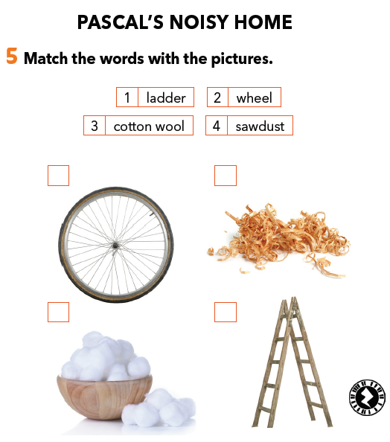
Match the words with the pictures.
Read the subtitle. Who do you think Pascal is?
Translate
wheel –
ladder –
cotton wool –
sawdust –
2
4
kotač
ljestve
vata
piljevina
Listen to the riddle. Who is talking?
Pascal is talking. He is a hamster.
3
1

Slide 8
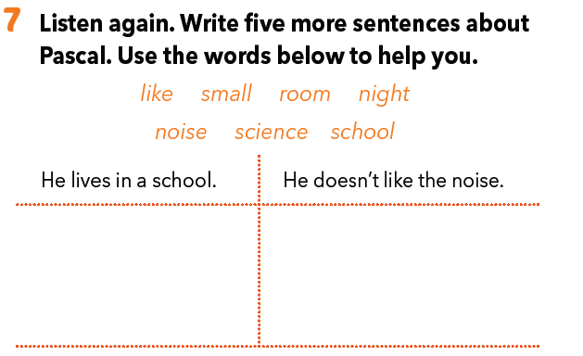
His home is very small.
He has got only one room.
He runs in a wheel at night.
The science teacher feeds him.

Slide 9
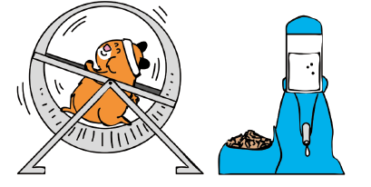
Do you know anyone who has a pet hamster?
What are they like?

Slide 10
Let’s revise!
Match the words to the right topic.
https://learningapps.org/watch?v=pivdg7qnc18

Slide 11
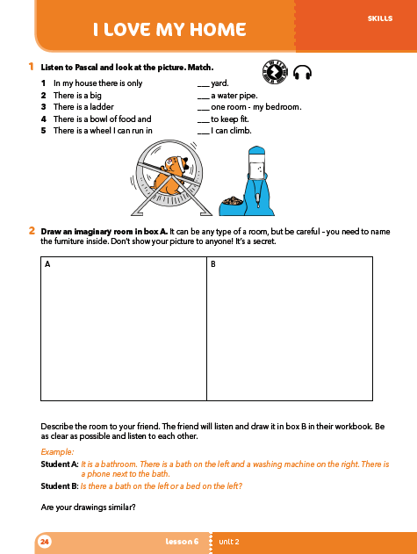
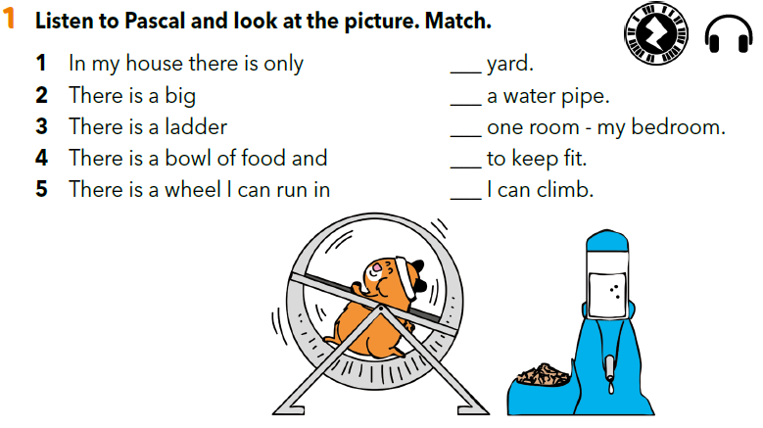
Workbook p 24.
2
4
1
5
3

Slide 12
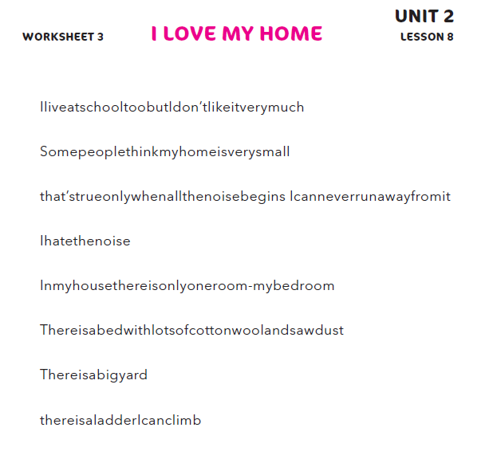
Write the sentences.
I live at school too, but I don’t like it very much.
Some people think my home is very small.
That’s true only when all the noise begins. I can never run away from it.
I hate the noise.
In my house there is only one room – my bedroom.
There is a bed with lots of cotton wool and sawdust.
There is a big yard.
There is a ladder I can climb.

Slide 13
Let’s revise - PREPOSITIONS OF PLACE.
https://wordwall.net/embed/a1a2ecbe334445efb554acc99951f863?themeId=0&templateId=22%27%20frameborder=%270

Slide 14
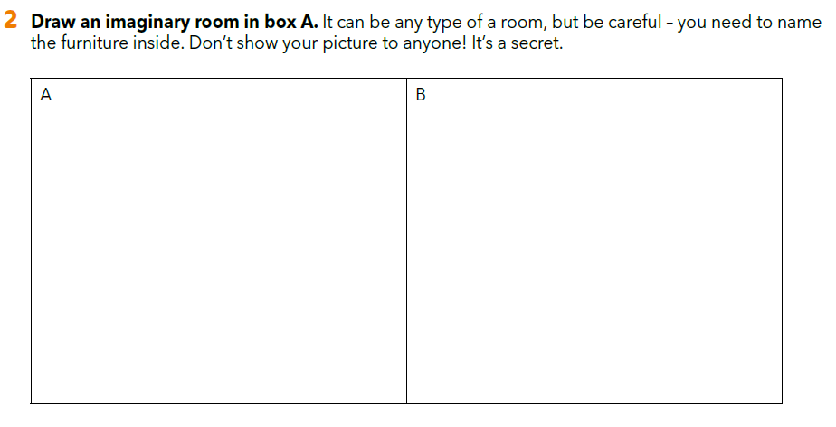
Workbook p 24

Slide 15
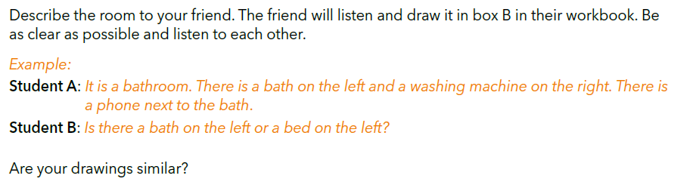

Slide 16
How do you feel?
Is this exercise easy for you?
Are you happy with your drawings?
Write a description of the room in your notebook.

Slide 17

LEARN MORE.
https://www.e-sfera.hr/dodatni-digitalni-sadrzaji/6da1a2ca-86a2-4ef0-9d1d-59f270e52c12/
Your Roommate
Read the text and complete the tasks below.

